Slide 1

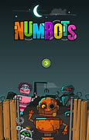

Reception Purple Mash and Numbots Workshop
Monday 11th March

Slide 2
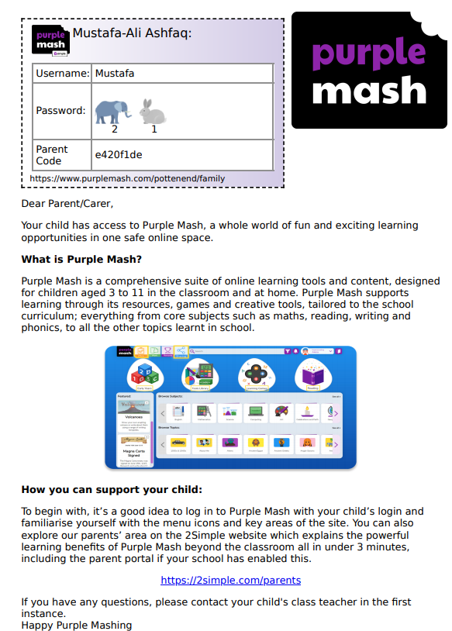


Log in Letter
At the top child’s name
User Name
Password
Parent Code

Slide 3
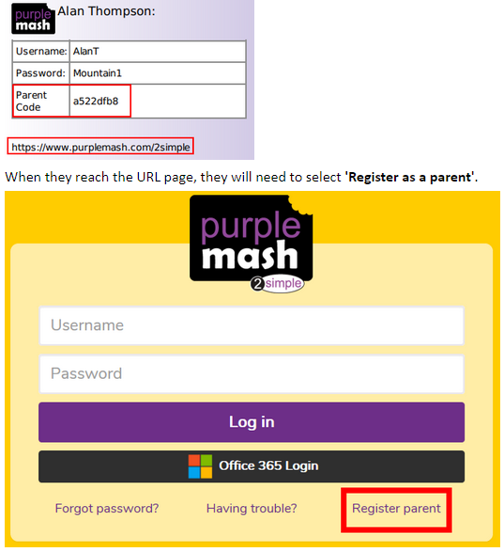
Parent Portal
Parent Portal is an exciting feature of Purple Mash which allows parents/carers to gain insight into your child's learning on Purple Mash. You can easily see all the activities associated with your child, including any rewards or approved work to display boards and blogs. A child may wish to share a piece of work with their parent, this too can easily be accessed via Parent Portal.
Registration
All login cards which are printed for pupils will have a Parent Code field on them. All parents need to do is use the URL on the login card along with the Parent Code to register for access to Parent Portal. Each child can have a maximum of four 'Parents' associated with them. At any point, a Parent can be disassociated/removed from a child's account.
URL : Unique resource locator (web address)

Slide 4
Mini Mash
A platform designed for Reception children, where they can learn through play.
Mini Mash is set out mirroring the areas of learning which your child is familiar with.
This includes an indoor and an outdoor area, which you can access by clicking on the purple door.
All these different areas, as in a school, are linked to the key areas of learning and development in early years.
As you move around the space, you will hear the children naming the different areas of learning.
Within each area, you will find lots of different resources which supports the learning taking place in school.

Slide 5
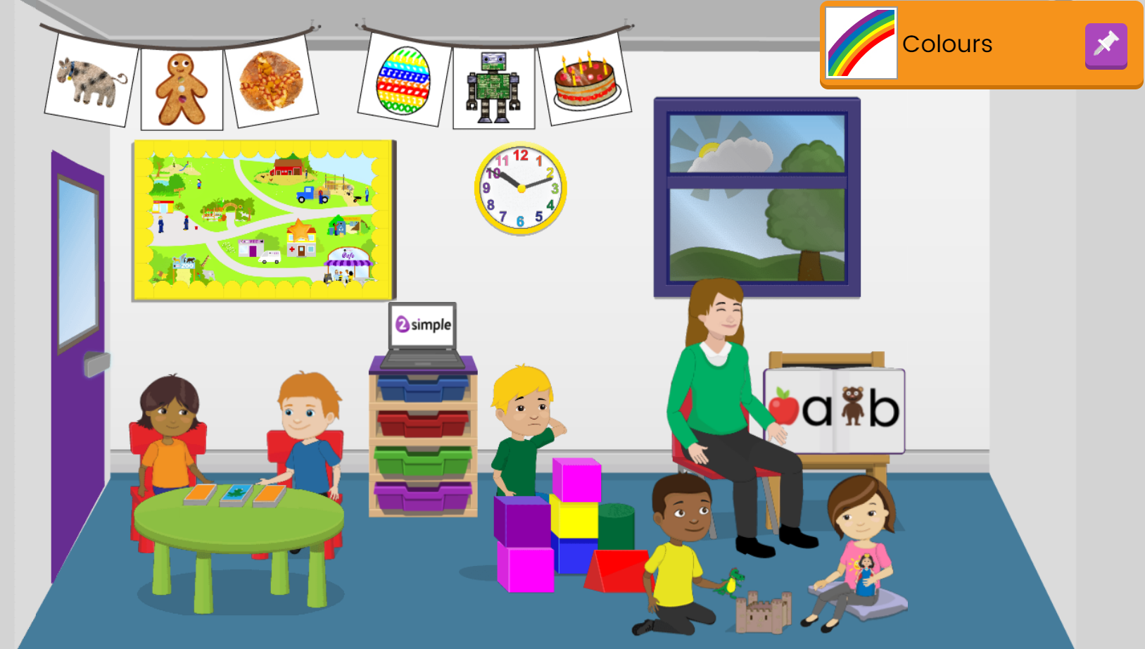

Slide 6
Areas Inside
Reading and Writing
Clicking on the teacher or the two children on the floor, your will access activities to develop reading and writing. They can create their own stories, practice sound recognition, and write words using their phonics skills.
Numbers and counting
Clicking on the boy with the blocks, it will take you to the maths area. Here, you can practice number recognition, record counting on a variety of 2count picture graphs, and explore measuring.
Games
Clicking on the table, you will find some different games linked to a range of early years topics.

Slide 7
Areas Inside – (continued)
Simple City
Clicking on the cityscape picture on the wall takes you to Simple City. Simple City allows you to explore, discuss and ask questions about different areas in the community. Areas in Simple City include the vets, the garden centre, the zoo, the farm and many more
Paint projects
Hanging from the ceiling you will see a variety of paintings which when clicked, take you to different paint projects where you can experiment with coloured and textured pens. There is also the option for them to mark-make or write words if you wish to

Slide 8
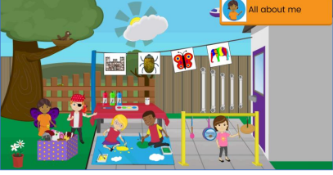

Slide 9
Areas outside
Music
In the music area, you can practice your expressive art skills using 2Beat and 2Explore. They can produce and record their own music sequences, exploring beat and rhythm with a wide variety of different sounds.
Drawing and Painting
In this area, there are a wealth of different paint projects which your child can explore and experiment with independently.
Roleplay
The ‘Mashcams’ here allow children to take a picture of themselves and imagine themselves as a variety of different characters. This can be an excellent exercise for children to develop their communication, imagination and self-confidence. Children can draw, record their voice, mark-make using the pens or type their own words about what their character might be feeling or saying.

Slide 10
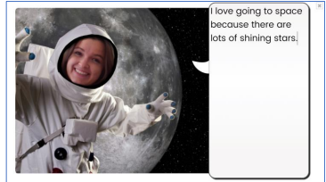
The children can also click on other objects both inside and outside to cause simple sounds and animations, such as the sun in the window, or the aeroplane in the sky.
When the clock is clicked, it becomes larger so children can begin to learn how to tell the time.

Slide 11
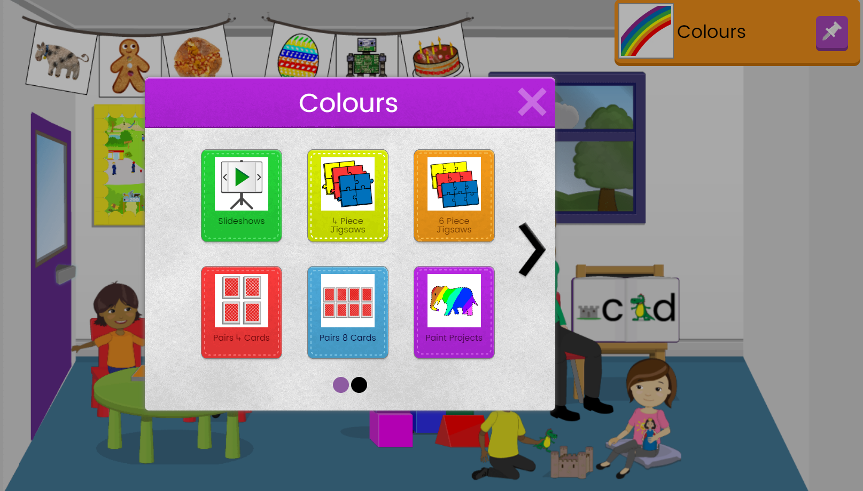
Topic Pins:
In the pictures, you will see the topic pin, ‘Colours’. When you click on this pin, you will see a range of resources linked to the topic for your child to explore.
Other topic pins will be posted linked to our current learning

Slide 12
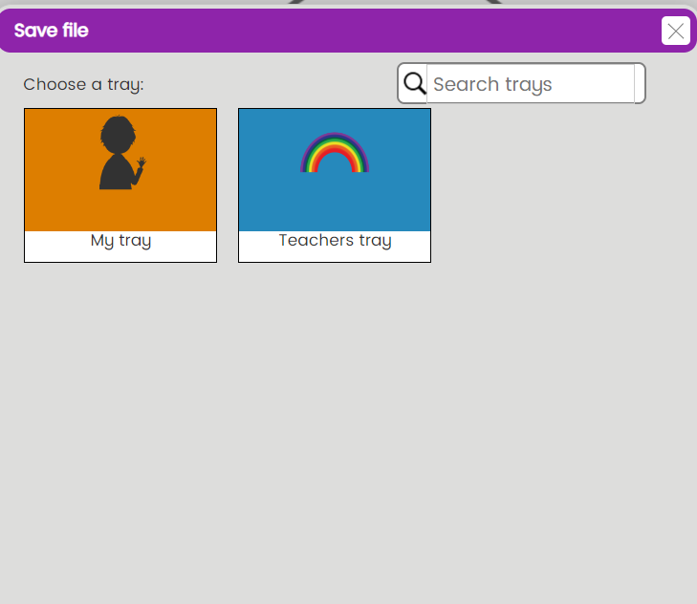
Saving your child’s work
Any work that your child does on Mini Mash, excluding Simple City, can be saved.
If you click on the purple icon at the top left of the screen or the red arrow on the top right, you will be given the option to ‘Save’.
Clicking here, you will see the pupil’s trays.
At any point, your child may look through their saved work by clicking on the trays in the main room, which will take them to their own tray.

Slide 13
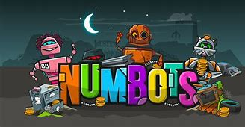

NumBots is all about every child achieving the “triple win” of understanding, recall and fluency in mental addition and subtraction, so that children move from counting to calculating.

Slide 14
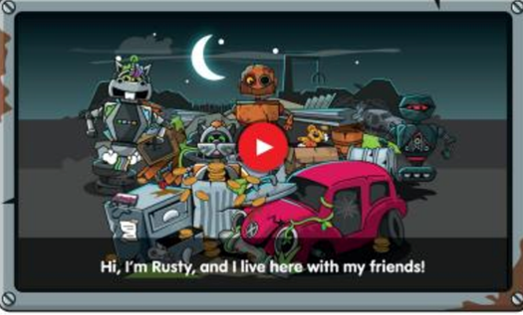
Before The Game
Children are welcomed to the game with an opening video, where they are introduced to the central character 'Rusty’. In the video Rusty asks for help in his quest to find new parts to upgrade him to a diamond robot so he can “shine inside and out, like a diamond” . Next, the child will play under, as well as their own robot character.

Slide 15

There are two play modes in NumBots that serve different purposes
STORY MODE - children work through the stages practising their counting and number facts.
Story mode starts with the very basic math(subitising numbers) and progresses steadily and rigorously to addition and subtraction of double digit numbers.
All children start with Rusty on Stage 1 and work their way up to Stage 18: Diamond

Slide 16


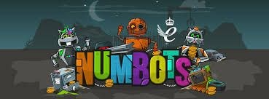
Playing The Game Story Mode
The game starts in ‘Story Mode’.
There are 18 stages from Rust to Diamond-and each stage is made up of a number of levels. Players start at Rust level 1 and, to unlock the next level they need to earn at least 2 out of 3 stars.
To earn the 2 or 3 starts to pass the level, children must demonstrate a level of fluency when answering the questions. This means thy must be accurate and timely with their answers; if children get 0 or 1 starts they need to answer more quickly.
The game ensures that learners don’t move on to the next level until they show they are prepared for it

Slide 17
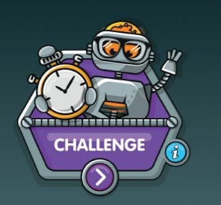
Playing The Game- CHALLENGE MODE
Children choose a challenge and race against the clock to see how many questions they can answer correctly one minute.
When players complete Stage 3 (Tin) : Level 35 in Story Mode, unlocks Challenge Mode. Here they can race the clock to test themselves on how many questions they can answer correctly in one minute. There are 20 different challenges to choose from ; each challenge testing a different skill, for example number bonds to 10, adding single digits or subtracting double digits.

Slide 18

How can parents support?
We recommend that children play 5-10 minutes a day, 4 or 5 times a week. Little and often is best!
Some children may ned help at times; there is an information slie before each level begins to help!
Making mistakes is a good thing! We love growth mindset at Potten end! Praise effort and perseverance
Becoming stuck n a level? Go back to earlier ones and try and complete them with 3 stars
If children are still finding it difficult to complete levels with 2 stars, please speak to us. We can change the story settings or help with strategies

Slide 19

is a lot of fun! It’s also a great place for the children to practise their counting and number facts.
To get the best out of NumBots, we suggest children play for 5 minutes 4-5 times a week - little and often is the key.
Maths is really hard when your counting and number facts aren’t secure. NumBots is a great way to start building maths confidence.
If you have any questions at all, please ask. Thank-you for your support!

Slide 20
Thank you

