Slide 1

Information for parents and carers
Relationships, Health & Sex Education 2020
Consultant Version 2019-2020 V1.0

Slide 2

We aim to inform you of:
the school’s legal obligations on Relationships and Sex Education
(now and from September 2020)
your rights as a parent/carer
how, what, why and when we intend to teach children
School and home partnership

Slide 3

Where
and When?
Would accurate information at the right age and stage of development, coming from school AND home, be a better way?

Slide 4

What do you think children should know about relationships and why?
Relationships Education

Slide 5
What do you think children should know about relationships and why?
What a positive, healthy, caring, safe relationship looks and feels like
How to speak up and get help when a relationship does NOT feel healthy/positive/safe
How to make and maintain positive relationships
Relationships Education
(Online and offline relationships)

Slide 6
What does
the government say is the aim
‘Today’s children and young people are growing up in an increasingly complex world and living their lives seamlessly on and offline….children and young people need to know how to be safe and healthy, and how to manage their academic, personal and social lives in a positive way’
of Relationships Education?
Secretary of State for Education… Draft guidance 2019

Slide 7
children need to feel
physically safe
they have agency in their situation
in control of their emotions
valued
they belong
they are worthy
Relationships and Learning
These feelings are largely achieved through healthy, positive relationships…
so relationships help the learning process.

Slide 8
Right now, until September 2020
Legally:
Schools MUST teach the Science curriculum which includes some ‘sex education’ (body parts/living and growing)
The DfE guidance 2000 requires schools publish their policy on SRE
(Sex and Relationships Education)
Sex Education
Plus
The DfE 2000 guidance ‘recommends’ all schools have a Sex and Relationships Education Programme (p9)
that ensures ‘boys and girls know about puberty and how a baby is born’
How schools do this is left up to them

Slide 9
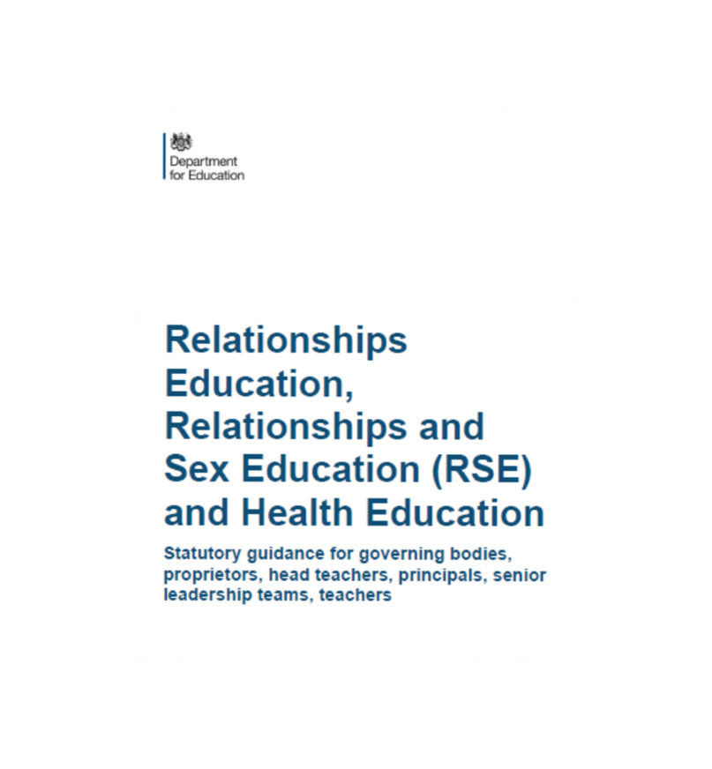
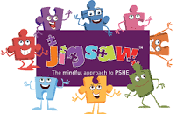
From September 2020
The Government has set out new statutory guidance for Relationships Education, Relationships and Sex Education and Health Education.
To help our school deliver this we will be using Jigsaw, which offers a whole school approach to teaching PSHE.
The children will work on the same theme (puzzle piece) at the same time. There are 6 puzzle pieces which cover everything in the statutory guidance.

Slide 10

What are the expectations for Science related to Sex Education?
Statutory Science programmes of study:
key stages 1 and 2 National curriculum in England September 2013
Year 1
identify, name, draw and label the basic parts of the human body and say which part of the body is associated with each sense.
Year 2
notice that animals, including humans, have offspring which grow into adults
(Non-statutory note: Pupils should be introduced to …the processes of reproduction and growth in animals. The focus at this stage should be on questions that help pupils to recognise growth; they should not be expected to understand how reproduction occurs)
Years 3 and 4
Nothing in Science curriculum related to puberty or reproduction!
© Jan Lever

Slide 11

What are the expectations for Science related to Sex Education?
Year 5
describe the differences in the life cycles of a mammal, an amphibian, an insect and a bird
describe the life process of reproduction in some plants and animals
(Non-statutory note: Pupils should find out about different types of reproduction, including sexual and asexual reproduction in plants, and sexual reproduction in animals)
describe the changes as humans develop to old age.
(Non-statutory note: Pupils should draw a timeline to indicate stages in the growth and development of humans. They should learn about the changes experienced in puberty. Pupils could work scientifically by researching the gestation periods of other animals and comparing them with humans; by finding out and recording the length and mass of a baby as it grows)
© Jan Lever

Slide 12
What are the expectations for Science related to Sex Education?
Year 6
recognise that living things produce offspring of the same kind,
but normally offspring vary and are not identical to their parents
QUESTIONS:
Is this enough to ensure children know about puberty and how babies are born?
Is this enough information to help children keep themselves SAFE in today’s world?
© Jan Lever

Slide 13
Today’s considerations
The internet
Television
Social media
Other media
Friends
Family
School

Slide 14
Keeping children SAFE
Ignorance does not protect innocence… but may make children vulnerable.
PSHE (Personal, Social, Health Education) including Relationships Education, Health Education and Sex Education aims to keep children safe.
We believe we need to teach Relationships and Sex Education which goes further than the Science curriculum.

Slide 15
Don’t forget…
We are educating children and young people
to live in the real world, with all its contradictions
When it comes to sex, children’s heads are probably not empty – but they may be full of myths and half-truths
We mustn’t let our adult knowledge of relationships and sex prevent us seeing things from a child’s perspective
Our focus should be on building healthy attitudes and positive relationships, not just fighting off perceived threats

Slide 16
Schools must comply with The Equalities Act 2010
‘Schools must not unlawfully discriminate against pupils because of their age, sex, race, disability, religion or belief, gender reassignment…or sexual orientation (protected characteristics)
‘Schools should be alive to issues such as everyday sexism, misogyny, homophobia and gender stereotypes and take positive action to build a culture where these are not tolerated’
PSHE is a key part of this. All children are valued and included.

Slide 17

And the new Ofsted framework (2019)
Judgements:
Overall effectiveness and
x4 key judgements …
  Quality of education
  Behaviour and attitude
  Personal development
  Leadership and management

Slide 18
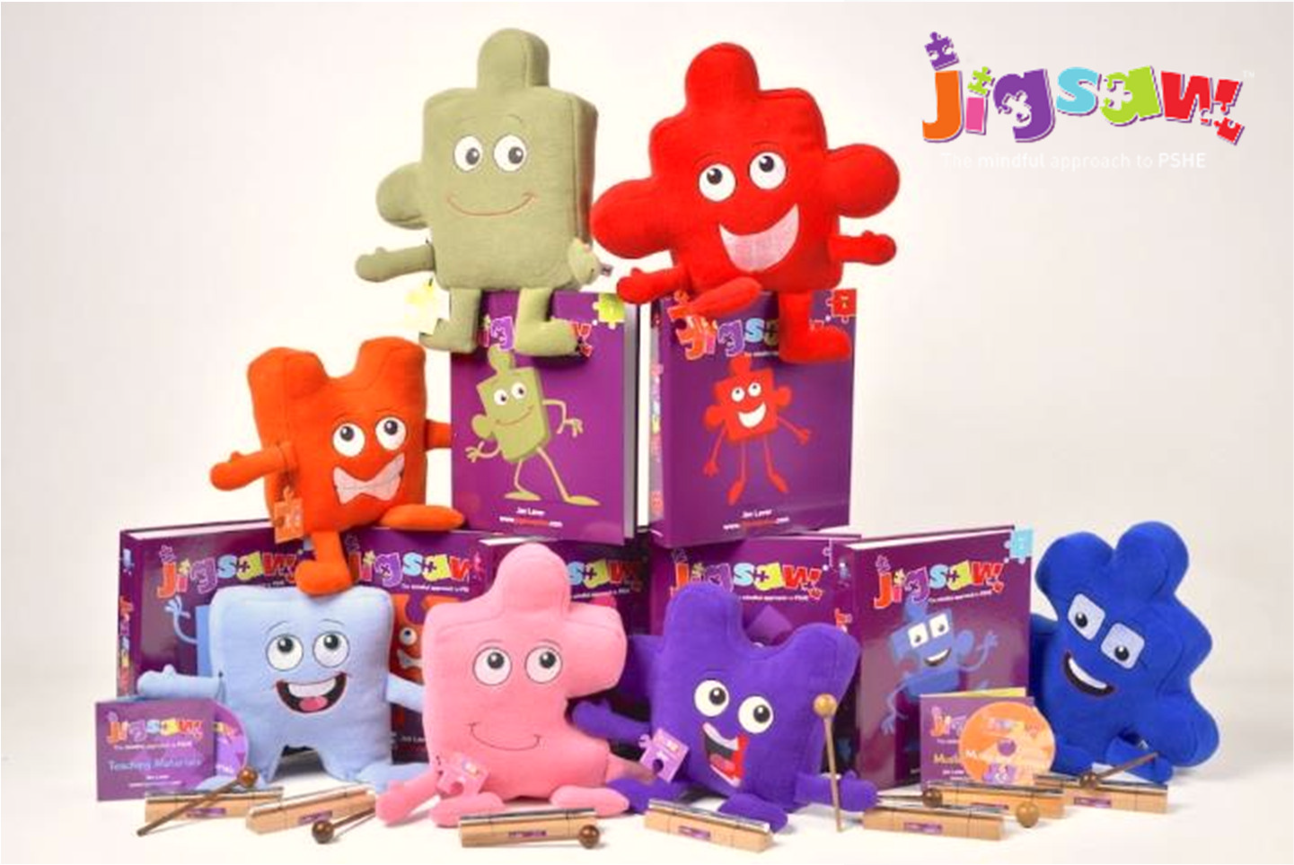
So, what, where, when and how do we do this?…

Slide 19




Whole-school approach from 3-11
Relationships
Values
Mental health
Self-esteem
Social skills
Safeguarding inc.
Internet safety
(Golden Threads)

Slide 20
We aim to inform you of:
the school’s legal obligations on Relationships and Sex Education
your rights as a parent/carer
how, what, why and when we intend to teach children
School and home partnership

Slide 21

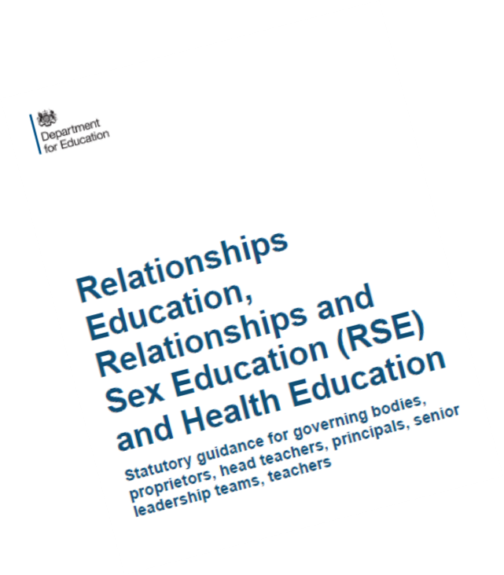
What are the content expectations for Relationships Education Primary?
Families and people who care for me
Caring friendships
Respectful relationships
Online relationships
Being safe

Slide 22

What are the expectations for Health Education?
Health Education (also statutory from September 2010)
includes:
Mental wellbeing
Internet safety and harms
Physical health and fitness
Healthy eating
Drugs, alcohol and tobacco
Health and prevention
Basic First Aid
Changing adolescent body

Slide 23
Recap… Sex Education:
The guidance says:
Both boys and girls are prepared for the changes that adolescence brings and drawing on knowledge of the human life cycle set out in National Curriculum Science, how a baby is conceived and born.
Puberty (in Health Education…statutory)
Where do babies come from?
This is covered in the science curriculum (statutory) Jigsaw our PSHE curriculum includes human reproduction in Years 4,5,6.

Slide 24
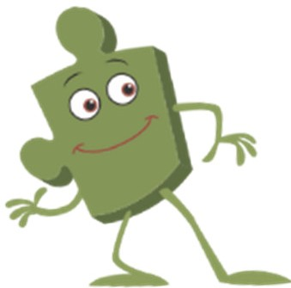
Parents’ rights…
Parents of primary-age children have the right to withdraw their children from some or all of Sex Education that is outside the Science Curriculum, but not to withdraw from Relationships Education, Health Education or Science.

Slide 25
So, what can parents withdraw their children from?
Where do babies come from? (if covered in non-statutory part of PSHE, but when this is covered in Science there is no parental right to withdraw)
This is the only aspect of PSHE parents have the right to withdraw from as Puberty work is in statutory Health Education.
You will be informed when your child’s class is covering this lesson so that you can write to us to say you would like them to be withdrawn.

